Slide 1
How Apache Kafka is transforming
Hadoop, Spark & Storm

Slide 2
What will you learn today?
Million Dollar Question! Why we need Kafka?
What is Kafka?
Kafka Architecture
Kafka with Hadoop
Kafka with Spark
Kafka with Storm
Companies using Kafka
Demo on Kafka Messaging Service…

Slide 3
Million Dollar Question!
Why we need Kafka??

Slide 4


Why Kafka Cluster?
Why Kafka is preferred in place of
more traditional brokers like JMS
and AMQP

Slide 5
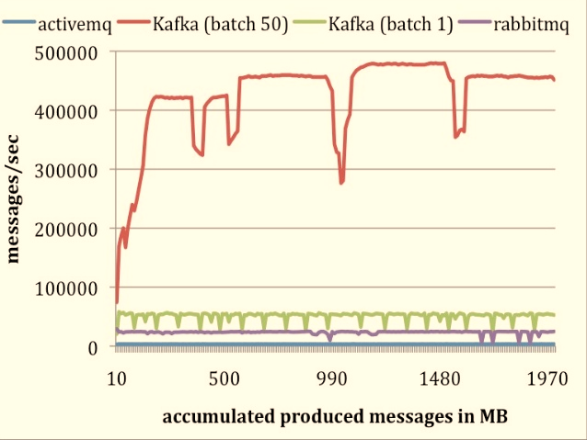
Kafka Producer Performance with Other Systems

Slide 6
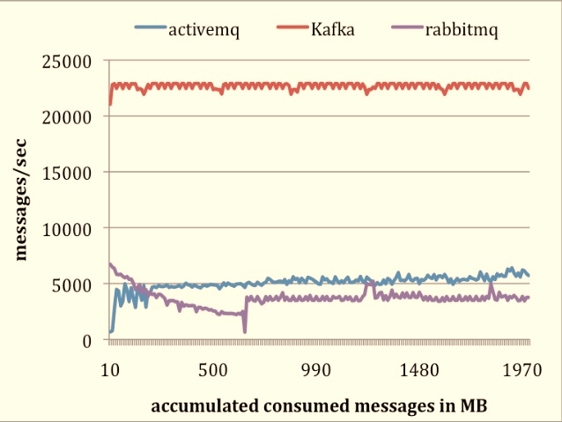
Kafka Consumer Performance with Other Systems

Slide 7
Salient Features of Kafka
Feature | Description
High Throughput | Support for millions of messages with modest hardware
Scalability | Highly scalable distributed systems with no downtime
Replication | Messages can be replicated across cluster, which provides support for multiple subscribers and also in case of failure balances the consumers
Durability | Provides support for persistence of messages to disk which can be further used for batch consumption
Stream Processing | Kafka can be used along with real time streaming applications like spark and storm
Data Loss | Kafka with the proper configurations can ensure zero data loss

Slide 8

Kafka Advantages
With Kafka, we can easily handle hundreds and thousands of messages in a second
The cluster can be expanded with no downtime, making Kafka highly scalable
Messages are replicated, which provides reliability and durability
Fault tolerant
Scalable

Slide 9
What is Kafka?

Slide 10

What is Kafka ?
A distributed publish-subscribe messaging system
Developed at LinkedIn Corporation
Provides solution to handle all activity stream data
Fully supported in Hadoop platform
Partitions real time consumption across cluster of machines
Provides a mechanism for parallel load into Hadoop

Slide 11
Apache Kafka – Overview
Frontend
Frontend
Frontend
External Tracking Proxy
Background Service (Producer)
Background Service (Consumer)
Kafka
Background Service (Producer)
Background Service (Consumer)
DWH
Hadoop

Slide 12
Kafka Architecture

Slide 13
Kafka Architecture
Producer
(Front End)
Producer
(Services)
Producer
(Proxies)
Producer
(Adapters)
Other Producer
Kafka
Kafka
Kafka
Kafka Broker
Zookeeper
Consumers (Real Time)
Consumers (NoSQL)
Consumers (Hadoop)
Consumers (Warehouses)
Other Producer

Slide 14
Kafka Core Components
Below table lists the core concepts of Kafka
Feature | Description
Topic | A category or feed to which messages are published
Producer | Publishes messages to the Kafka Topic
Consumer | Subscribes and consumes messages from Kafka Topic
Broker | Handles hundreds of megabytes of reads and writes

Slide 15
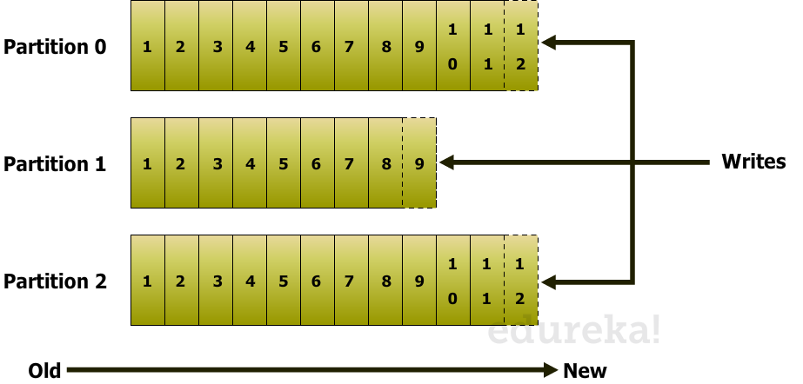
Kafka Topic
A user defined category where the messages are published
For each topic a partition log is maintained
Each partition basically contains an ordered, immutable sequence of messages where each message is assigned a sequential ID number called offset
Writes to a partition are generally sequential thereby reducing the number of hard disk seeks
Reading messages from partition can be random

Slide 16
Kafka Producers
Applications publishes messages to the topic in kafka cluster.
Can be of any kind like front end, streaming etc.
While writing messages, it is also possible to attach a key with the message
Same key will arrive in the same partition
Doesn’t wait for the acknowledgement from the kafka cluster
Publishes as much messages as fast as the broker in a cluster can handle
Producer
Producer
Kafka Clusters
Producer

Slide 17
Kafka Consumers
Applications subscribes and consumes messages from the brokers in Kafka cluster
Can be of any kind like real time consumers, NoSQL consumers, etc.
During consumption of messages from a topic, a consumer group can be configured with multiple consumers
Each consumer of consumer group reads messages from a unique subset of partitions in each topic they subscribe to
Messages with same key arrives at same consumer
Supports both Queuing and Publish-Subscribe
Consumers have to maintain the number of messages consumed
Consumer
Kafka Clusters
Consumer
Consumer

Slide 18
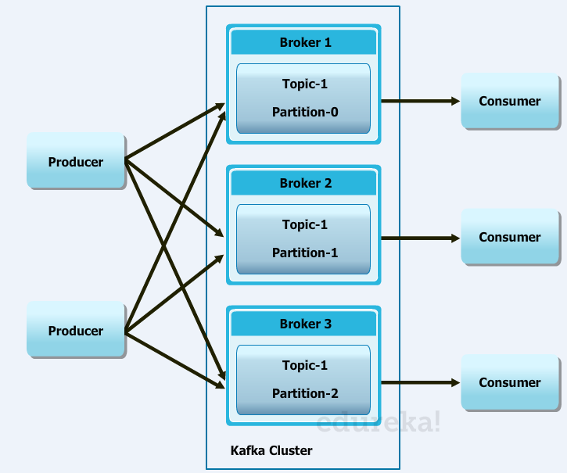
Kafka Brokers
Each server in the cluster is called a broker
Handles hundreds of MBs of writes from producers and reads from consumers
Retains all published messages irrespective of whether it is consumed or not
Retention is configured for n days
Published messages is available for consumptions for configured ‘n’ days and thereafter it is discarded
Works like a queue if consumer instances belong to same consumer group, else works like publish-subscribe

Slide 19
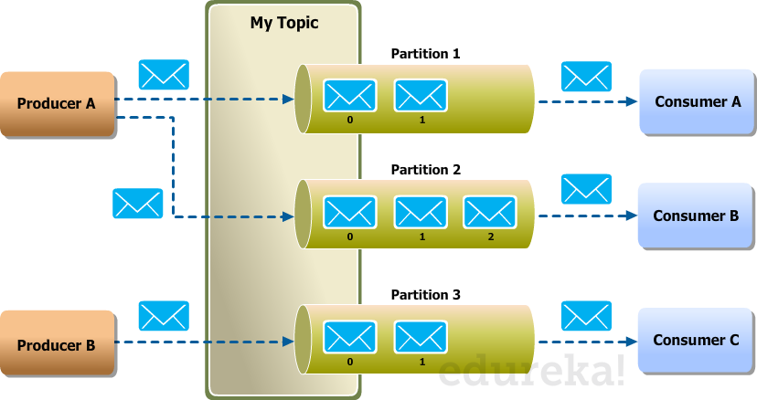
Kafka Producer-Broker-Consumer

Slide 20

How Kafka can be used with Hadoop

Slide 21
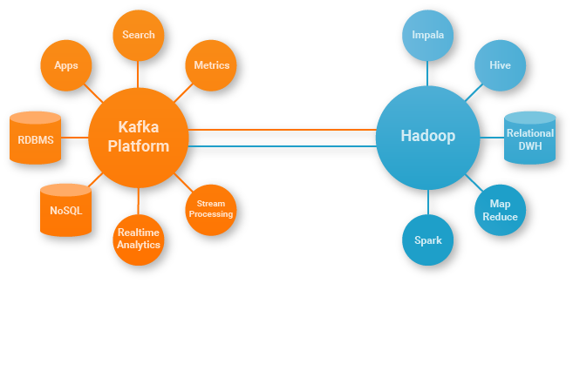
Kafka with Hadoop using Camus
Camus is LinkedIn's Kafka ->HDFS pipeline
It is a MapReduce job
Distributes data loads out of Kafka
At LinkedIn, it processes tens of billions of messages/day
All work done with one single Hadoop job
Courtesy : confluent

Slide 22

How Kafka can be used with Spark

Slide 23

Kafka With Spark Streaming
If messages are stored in ‘n’ partitions, parallel reading makes things faster
Generally in Kafka messages are stored in multiple partitions
Parallel reads can be effectively achieved by spark streaming
Parallelism of reads is achieved by integrating KafkaInputDStream of Spark with Kafka High Level Consumer API

Slide 24

Kafka With Spark Streaming
→ Generally in Kafka messages are stored in multiple partitions
APPS
Kafka
E V E N T S
STREAMING
ENGINE

Slide 25
How Kafka can be used with Storm

Slide 26
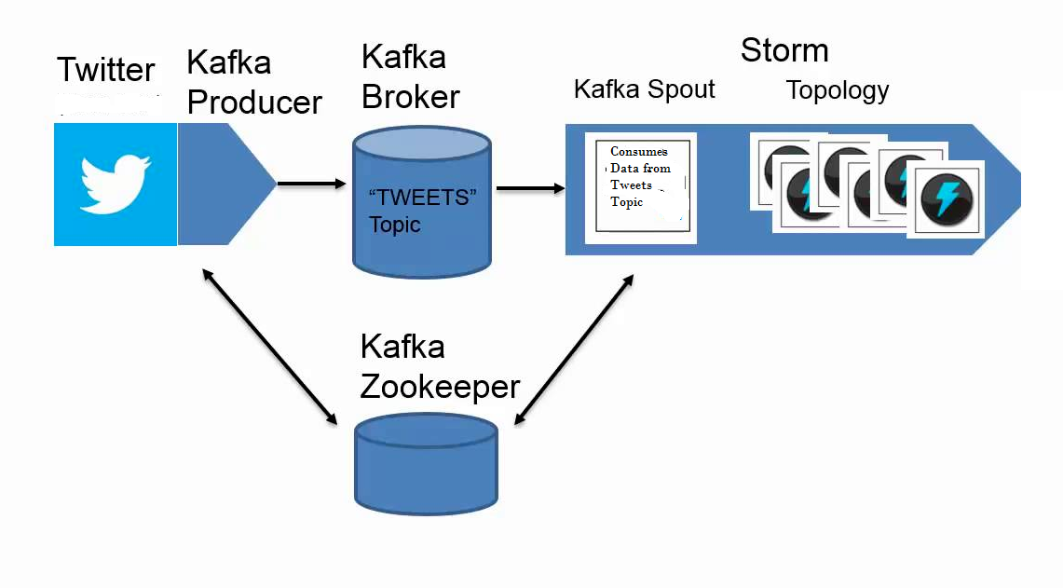
Kafka With Spark Streaming

Slide 27













Companies Using Kafka

Slide 28

Get Certified in Apache Kafka from Edureka
Go to www.edureka.co/apache-kafka
Batch starts from 10th October (Weekend Batch)
Edureka's Real-Time Analytics with Apache Kafka course:
Carefully designed to provide knowledge and skills to become a successful Kafka Big Data Developer
Helps you master the concepts of Kafka Cluster, Producers and Consumers, Kafka API, Kafka Integration with Hadoop, Storm and Spark
Encompasses the fundamental concepts like Kafka cluster, Kafka API to advance topics such as Kafka integration with Hadoop, Storm, Spark, Maven etc.
Online Live Courses: 15 hours
Assignments: 25 hours
Project: 20 hours
Lifetime Access + 24 X 7 Support

Slide 29
Thank You
Questions/Queries/Feedback/Survey
Recording and presentation will be made available to you within 24 hours

